Slide 1
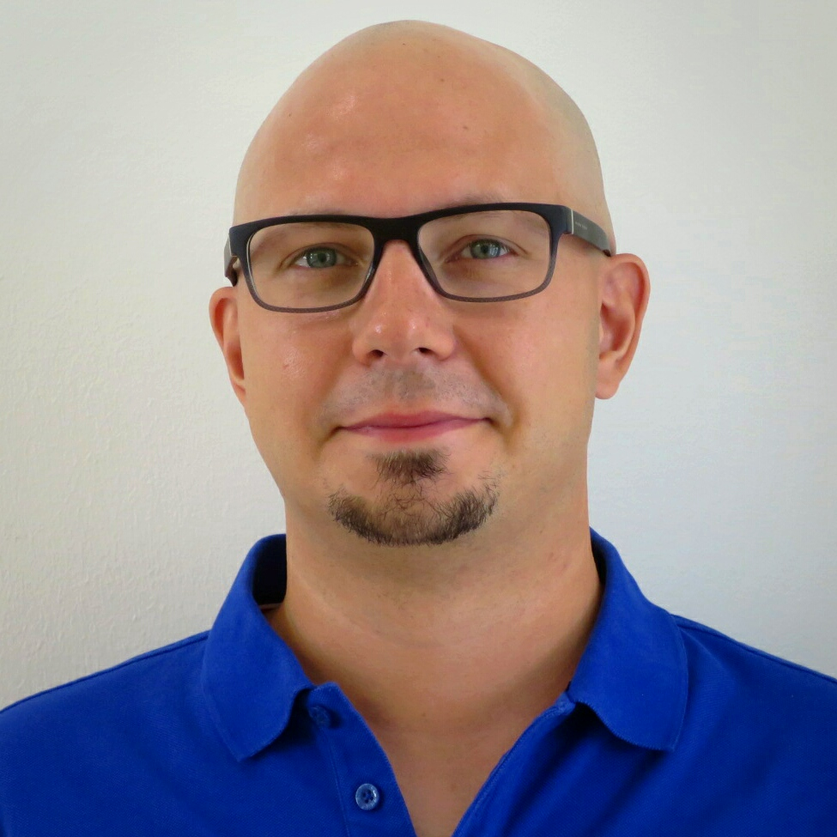



Microsoft Ignite 2018 in 30 minutes
Jukka Niiranen
Dynamics 365 Technical Lead
jukka.niiranen@dynamics365.fi
@jukkan
FDUG #1 - 18.10.2018

Slide 2
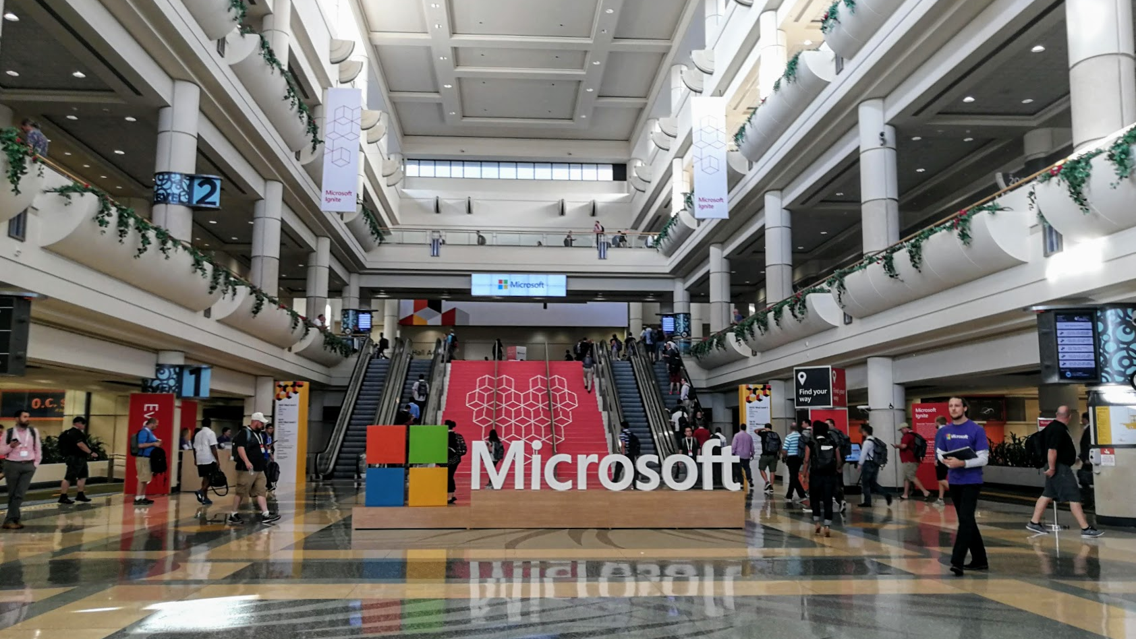


Slide 3
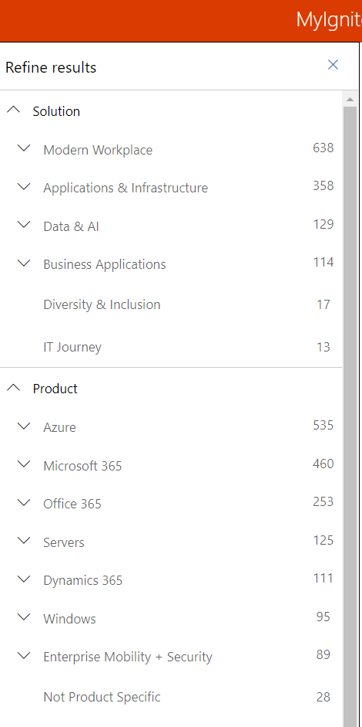
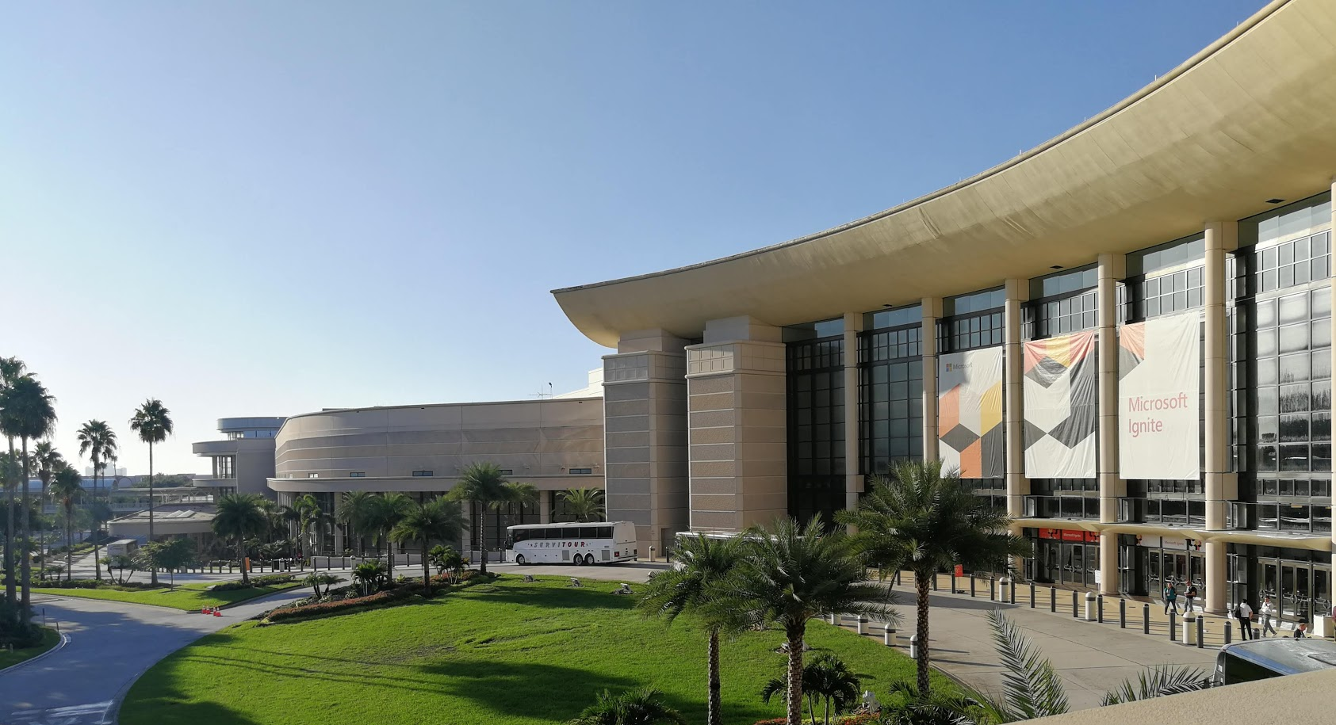
North + South Building
Ignite + Envision
5+1 days
30.000 attendees
1.600+ sessions
Hyatt Regency
International Drive
Hilton Orlando Envision
West Building
■ Microsoft Ignite
■ Microsoft Envision

Slide 4








Power Platform
Data connectors
PowerApps
Microsoft Flow
Power BI
Common Data Service
For Apps
Azure
Common Data Model
Sales
Service
Finance
Operations
Marketing
Healthcare
Commerce
Education

Slide 5
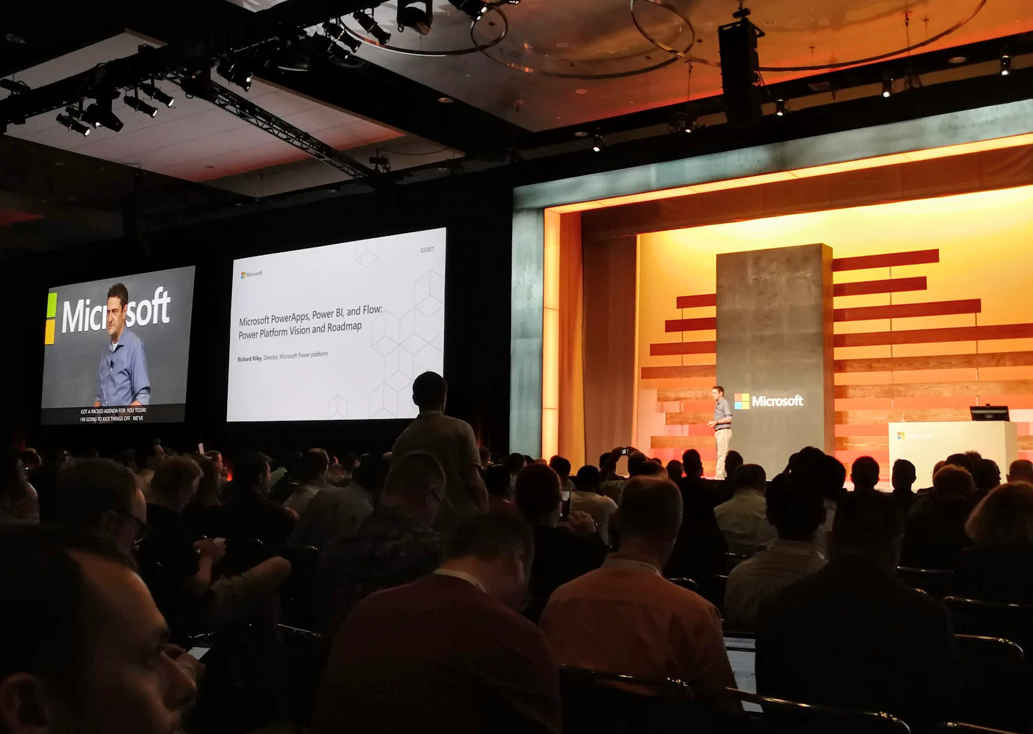
POWER PLATFORM
VISION

Slide 6

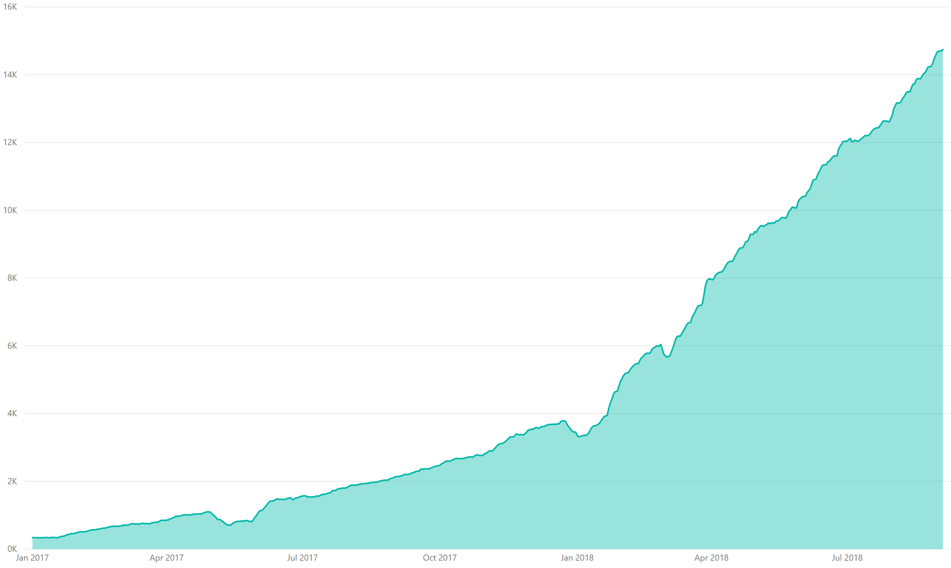
# of PowerApps used in production
>6X YoY
Ignite last year
GA

Slide 7
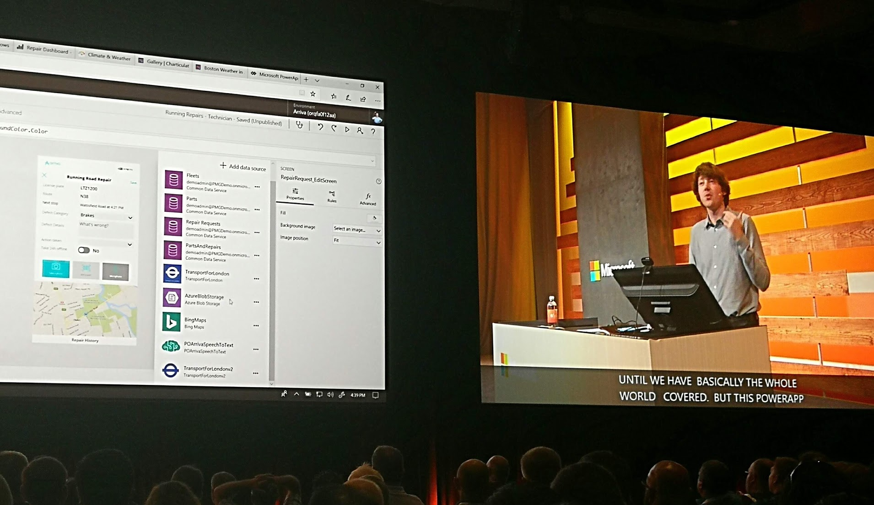
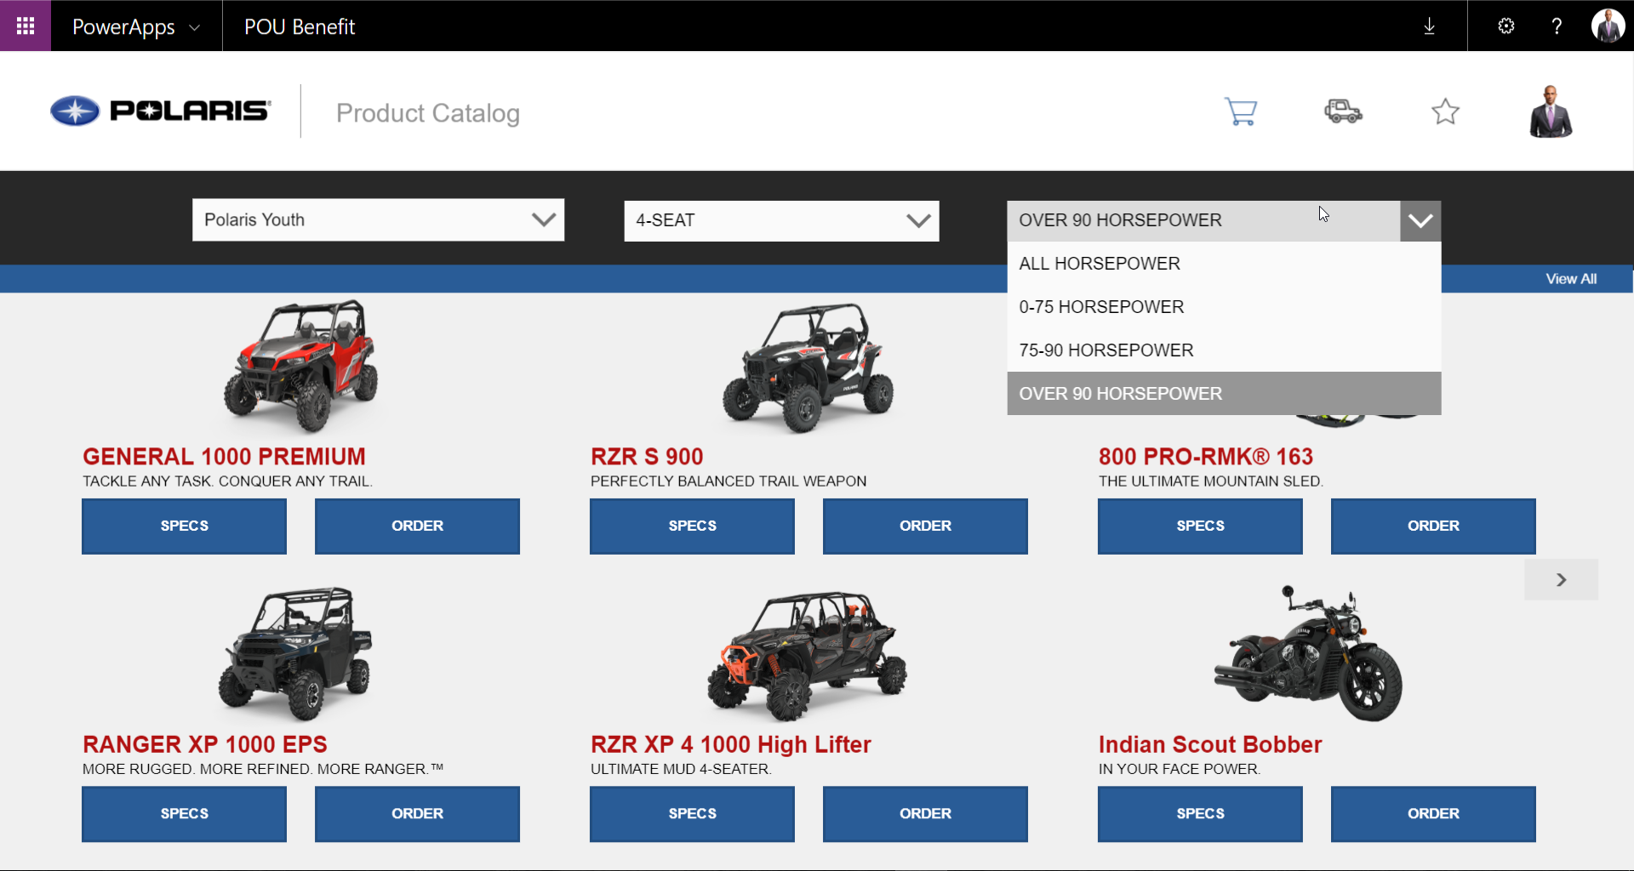
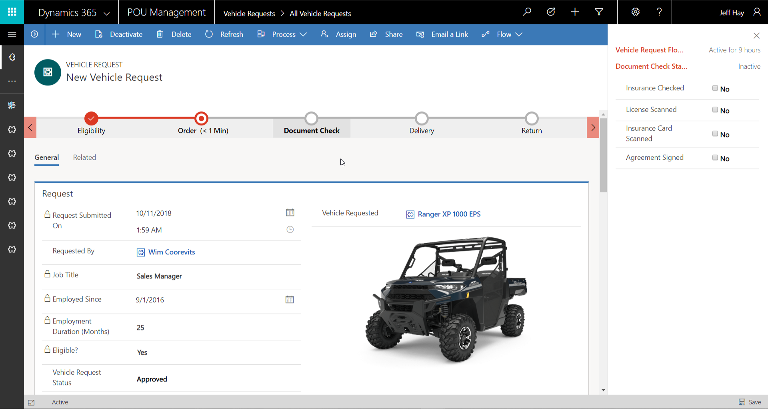
POWERAPPS:
Model-driven vs. Canvas apps

Slide 8
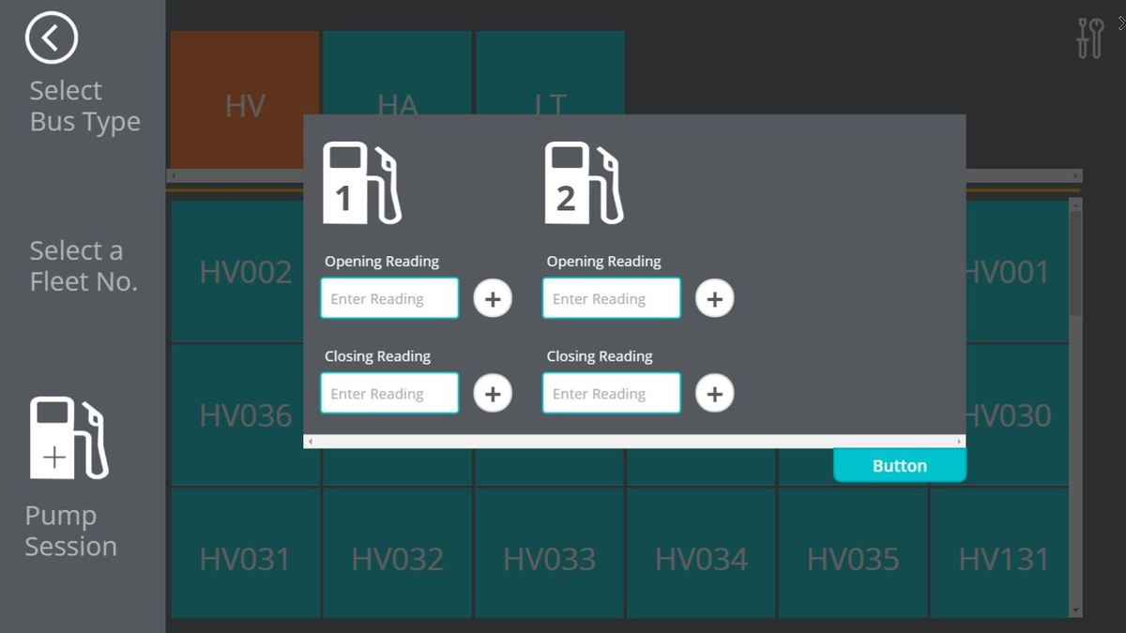

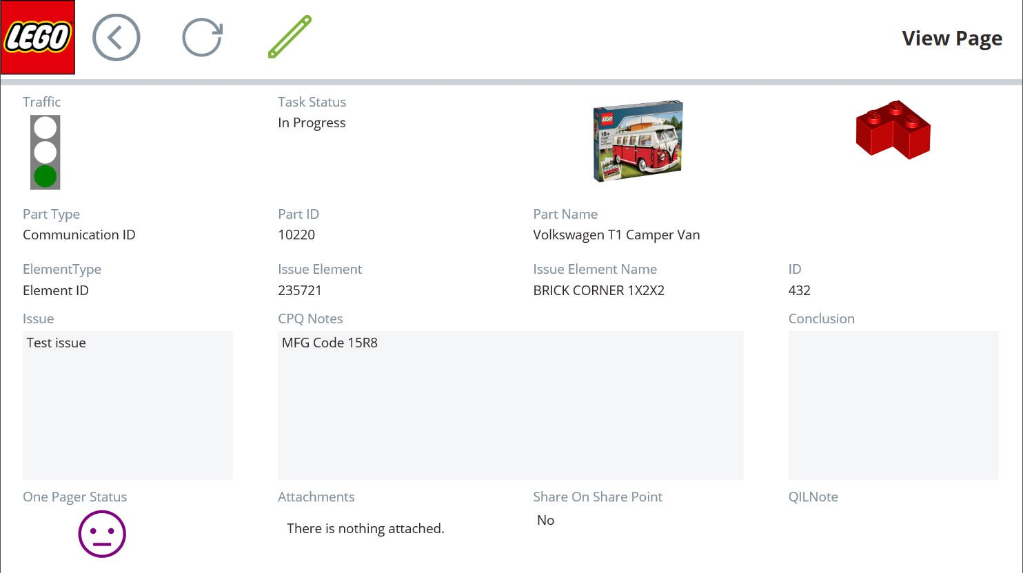

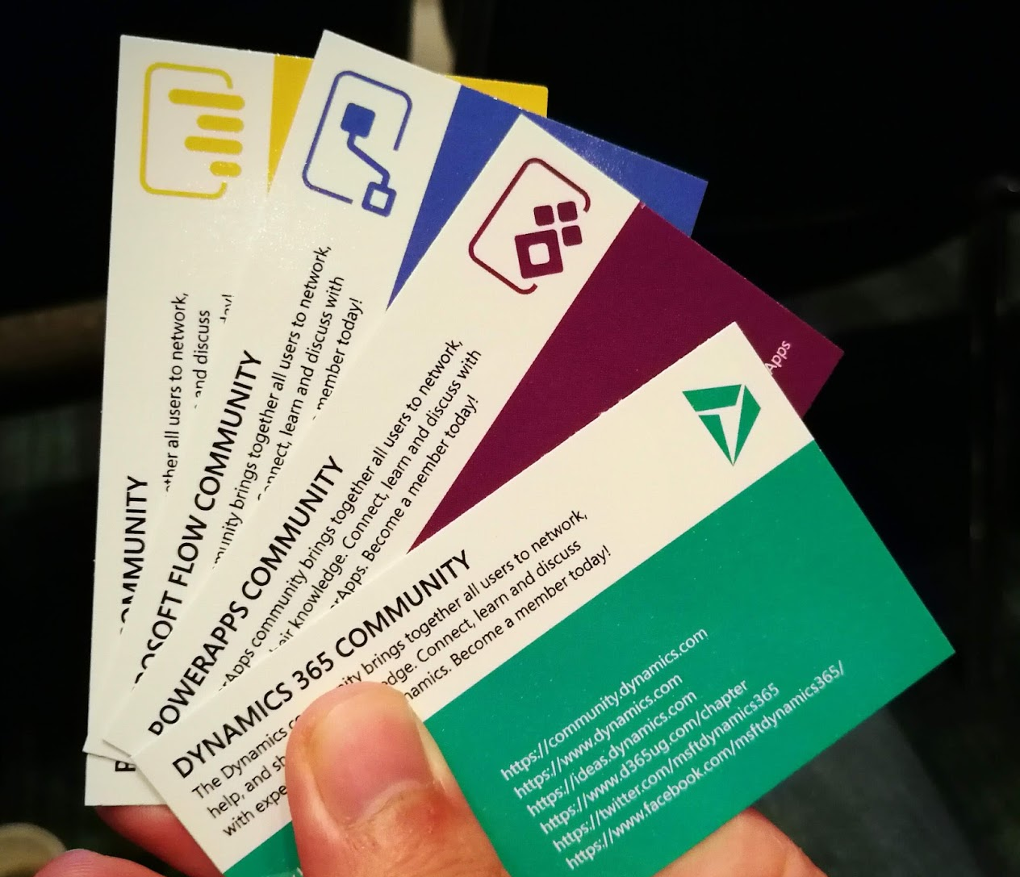

Power Platform community heroes on stage

Slide 9
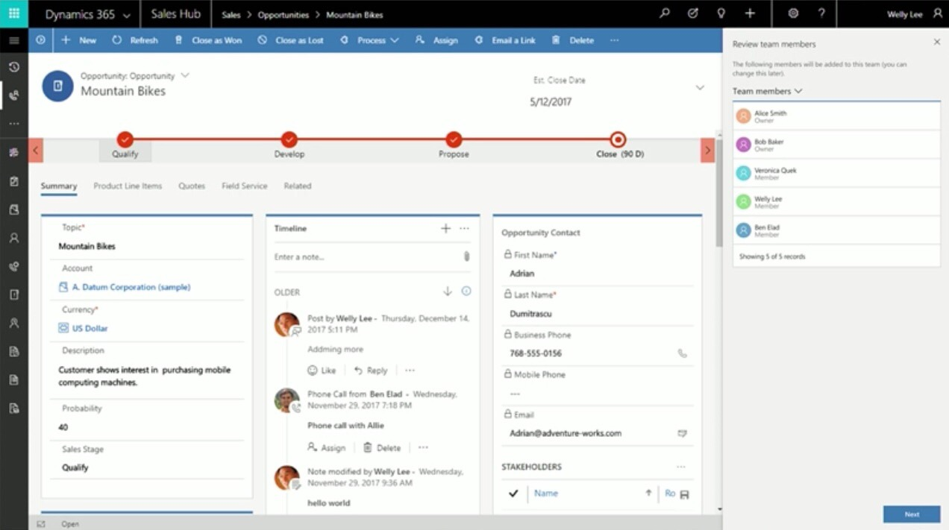
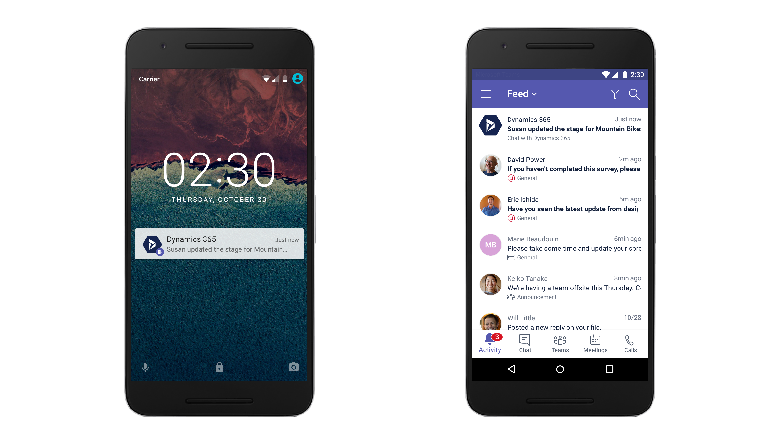
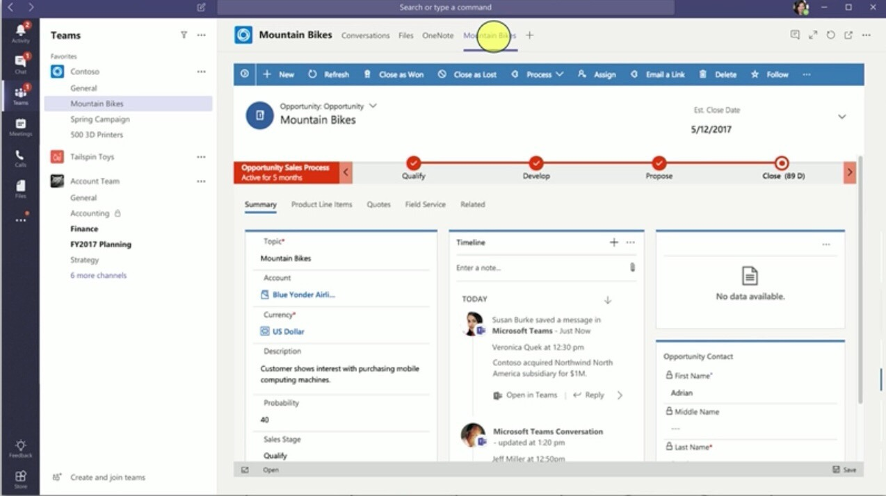
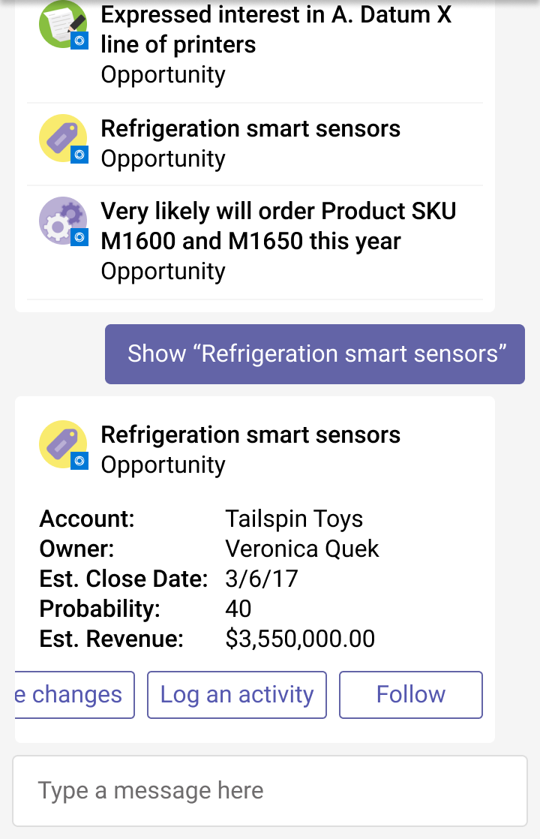
Dynamics 365 App for Microsoft Teams
BRK2056

Slide 10
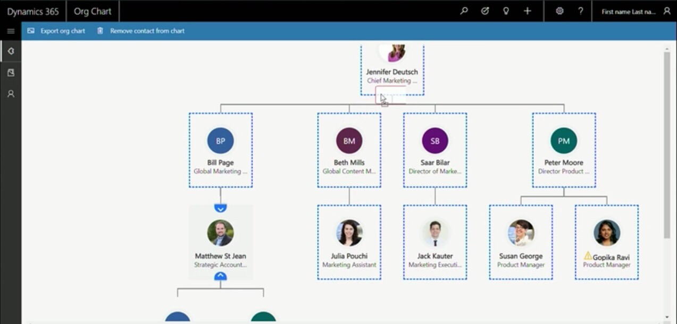
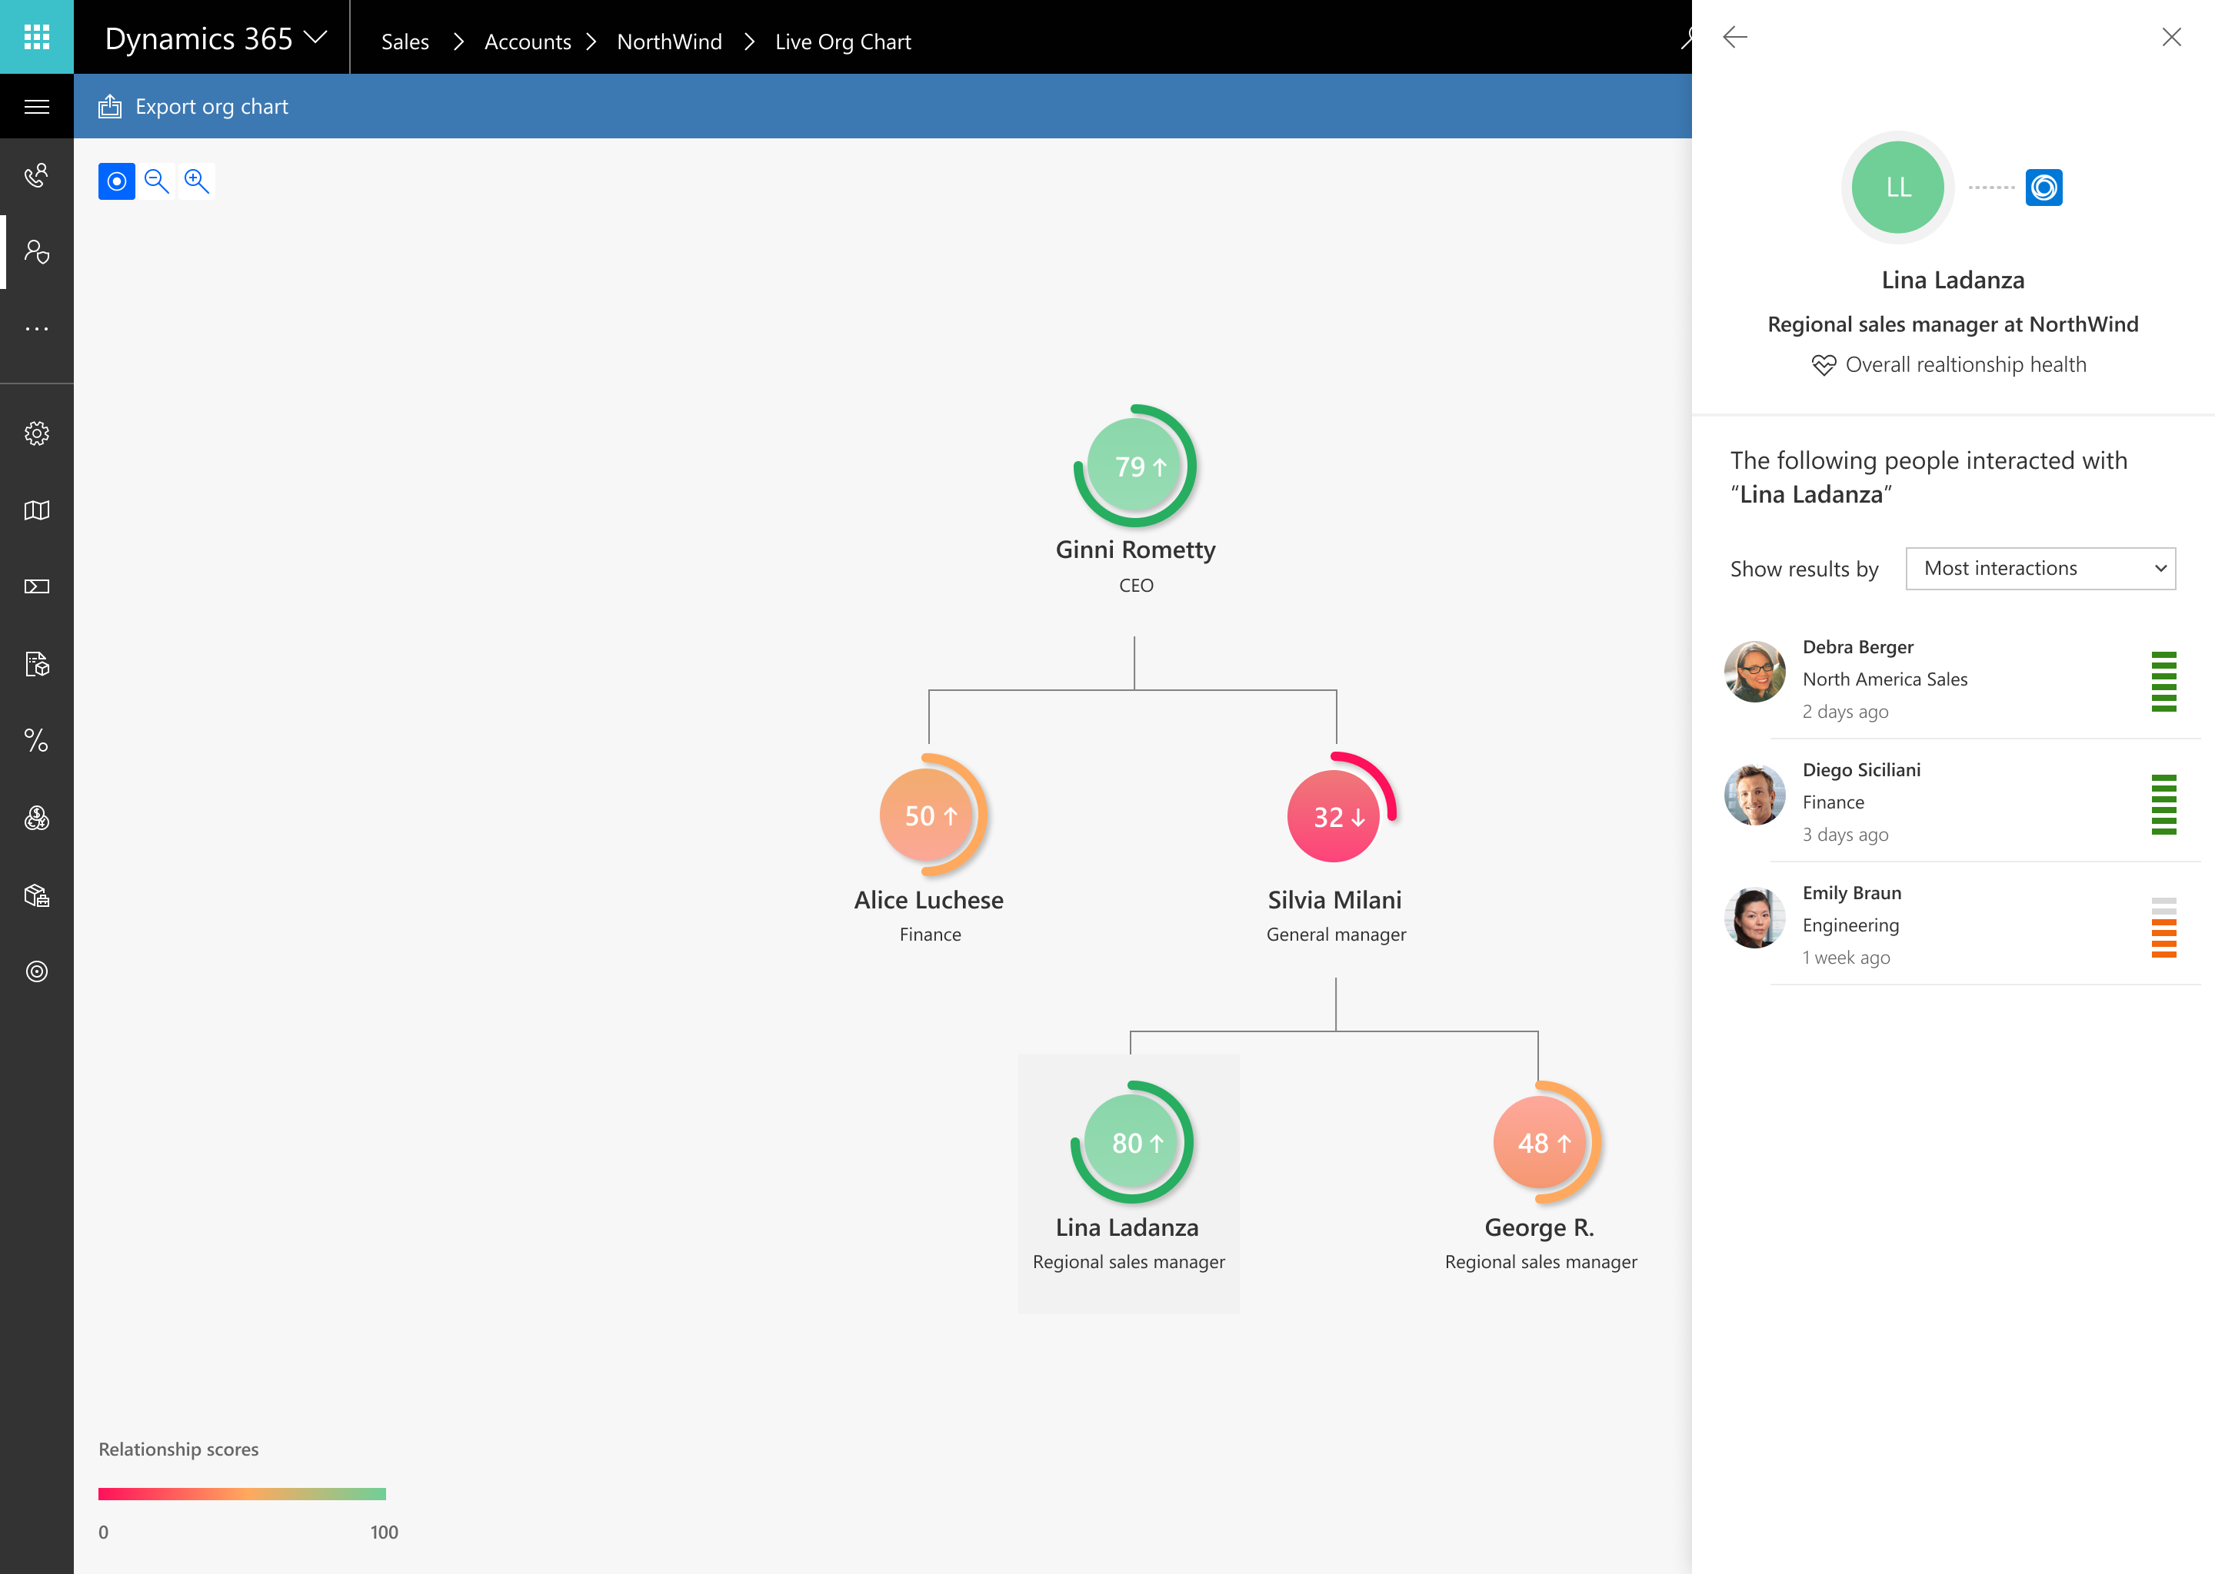
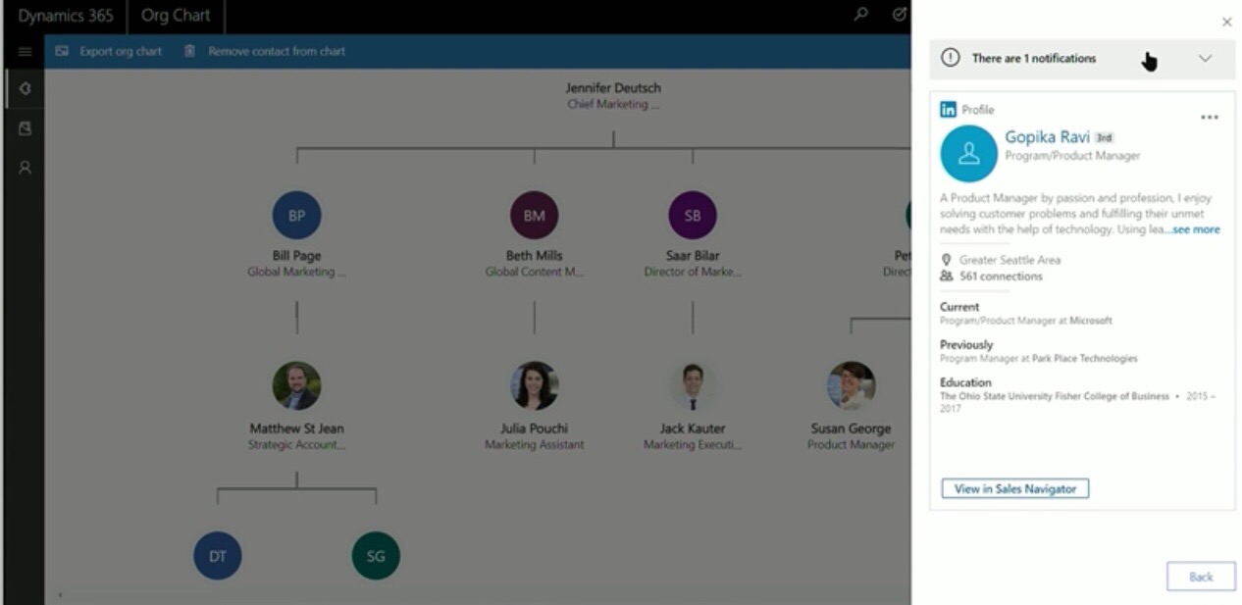
Live Organization Chart
BRK2129

Slide 11
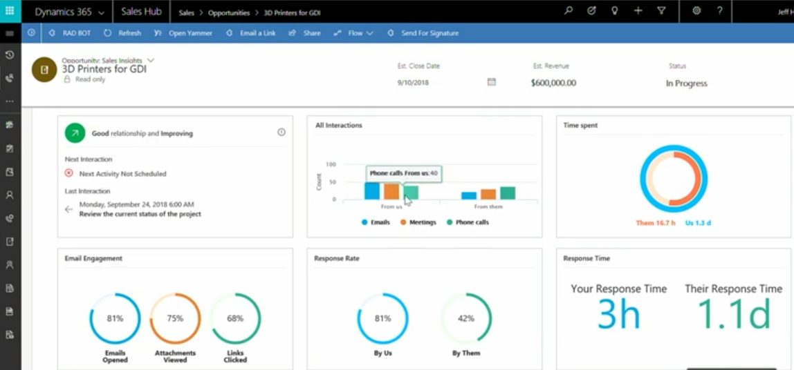
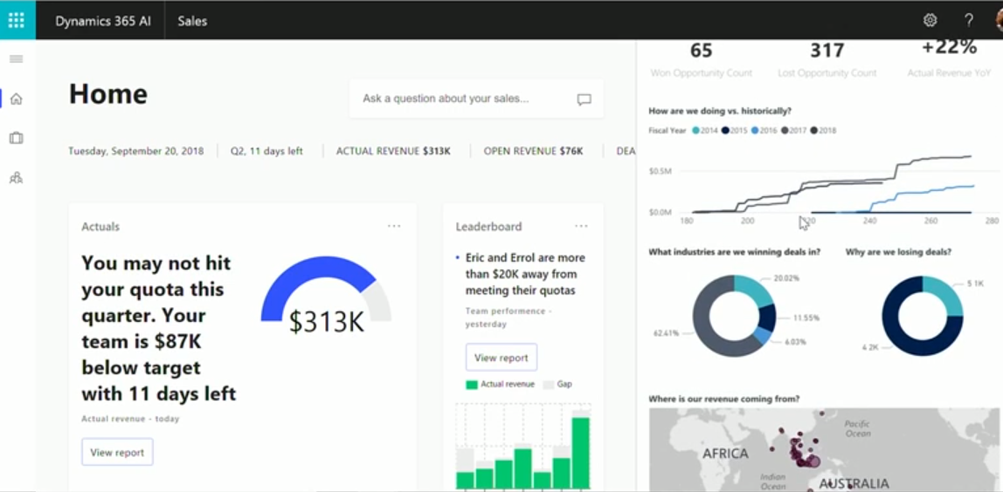
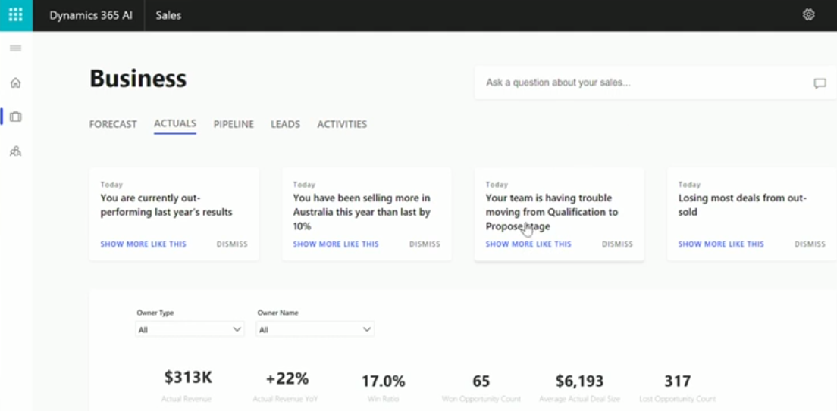
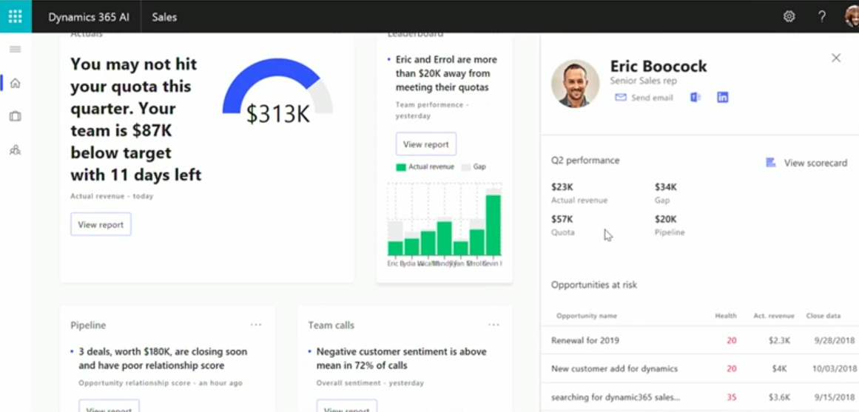
AI for Sales
BRK2398

Slide 12
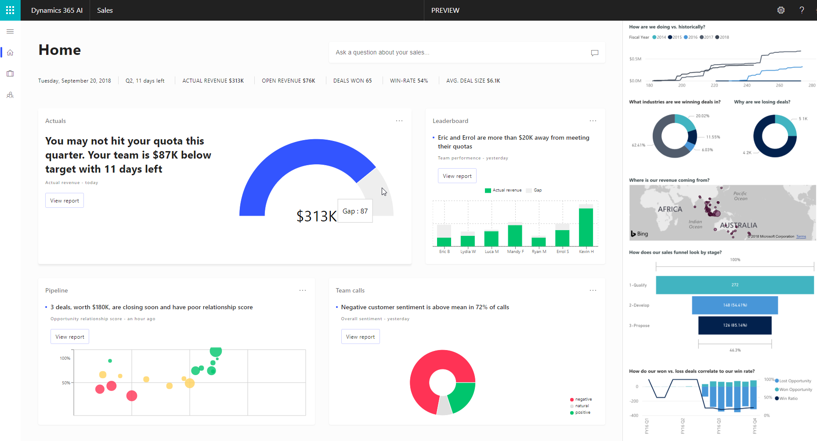

Slide 13
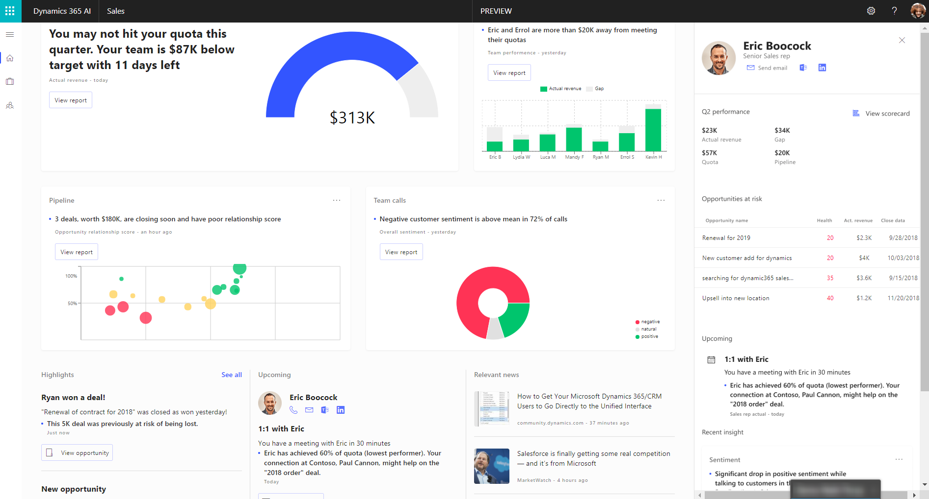

Slide 14
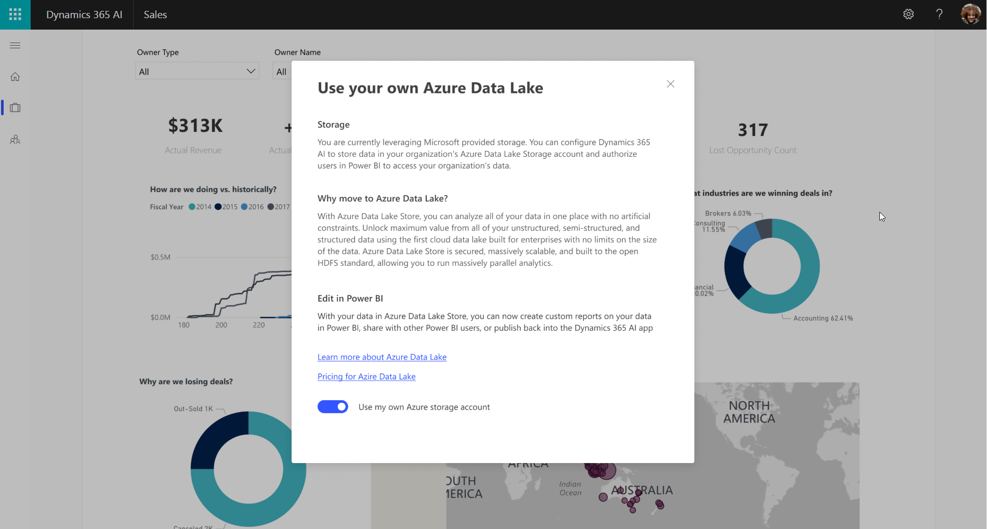

Slide 15
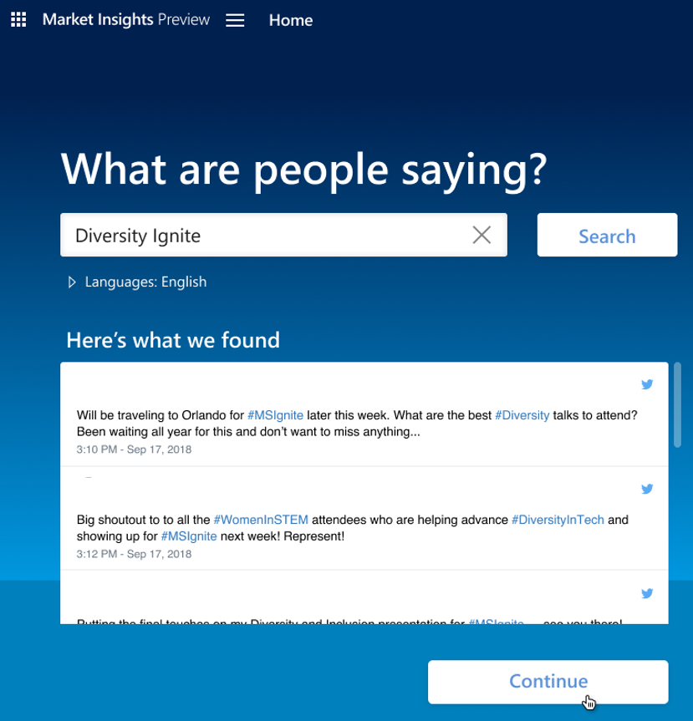
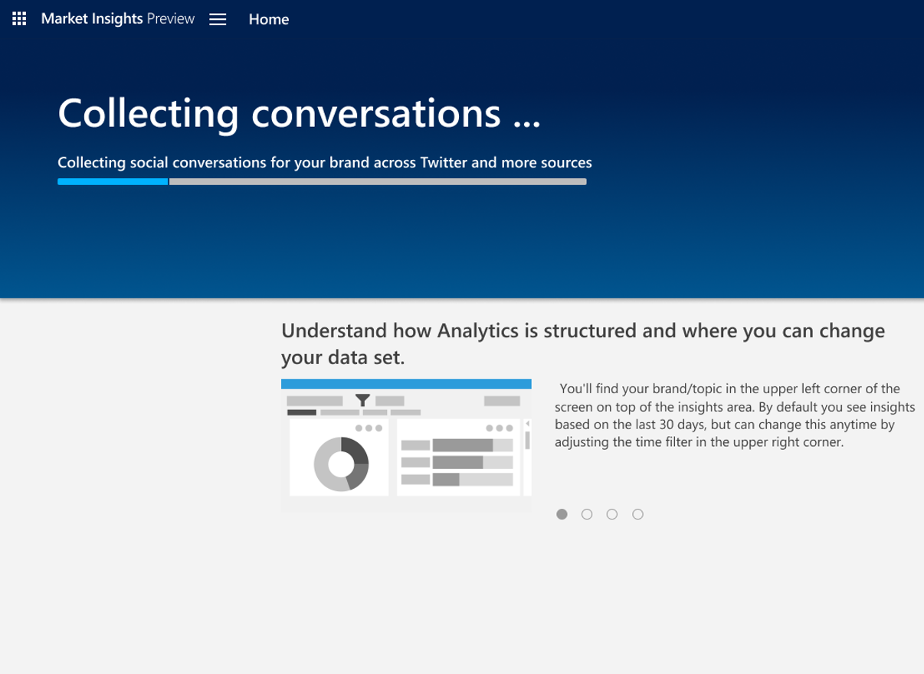
AI for Market Insights
BRK2247

Slide 16
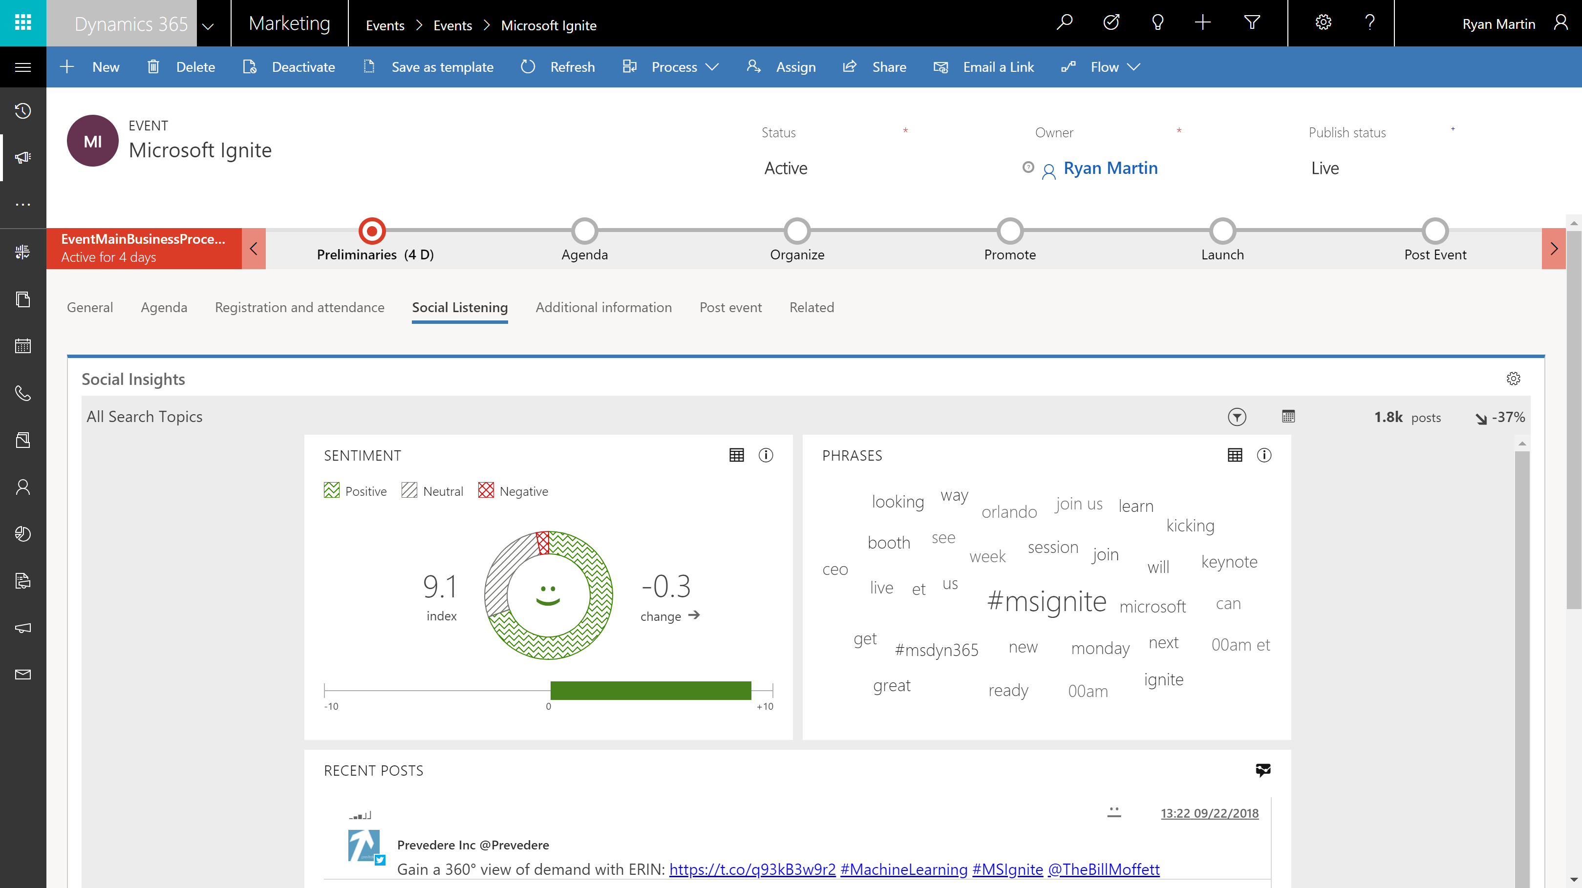

Slide 17
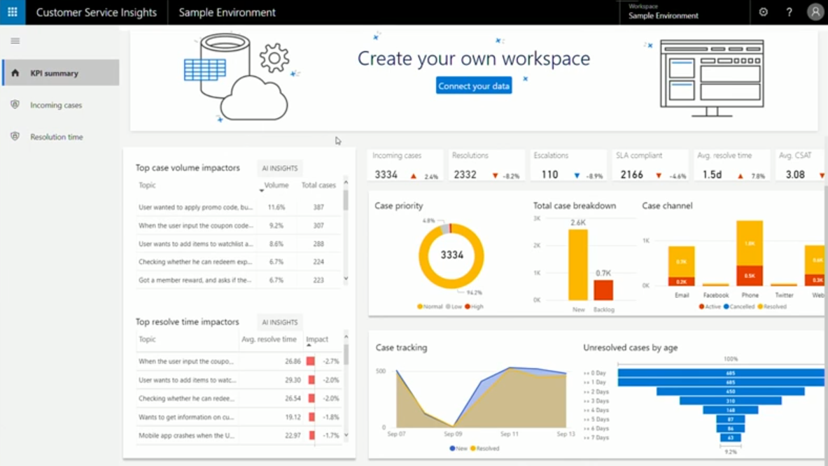
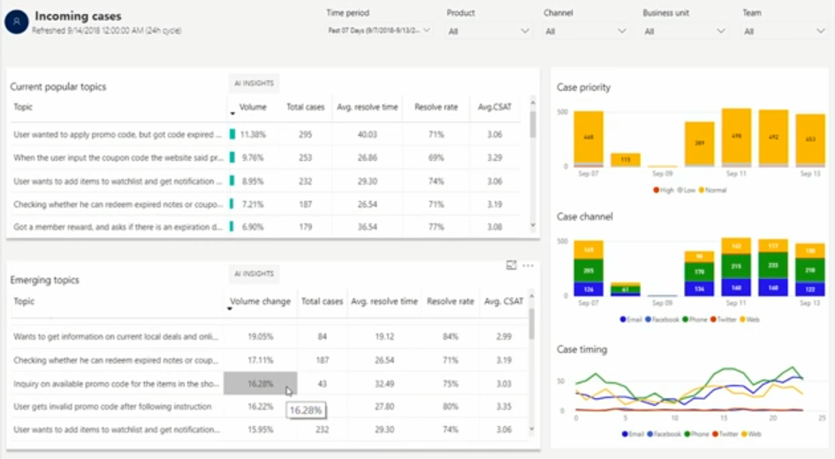
AI for Customer Service Insights
BRK2398

Slide 18
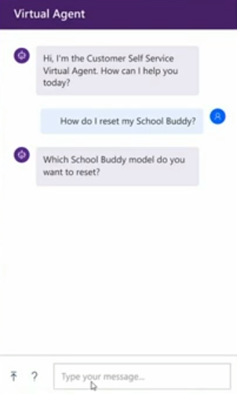
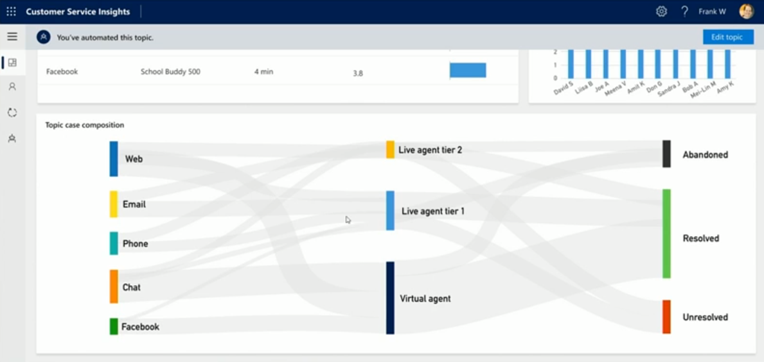
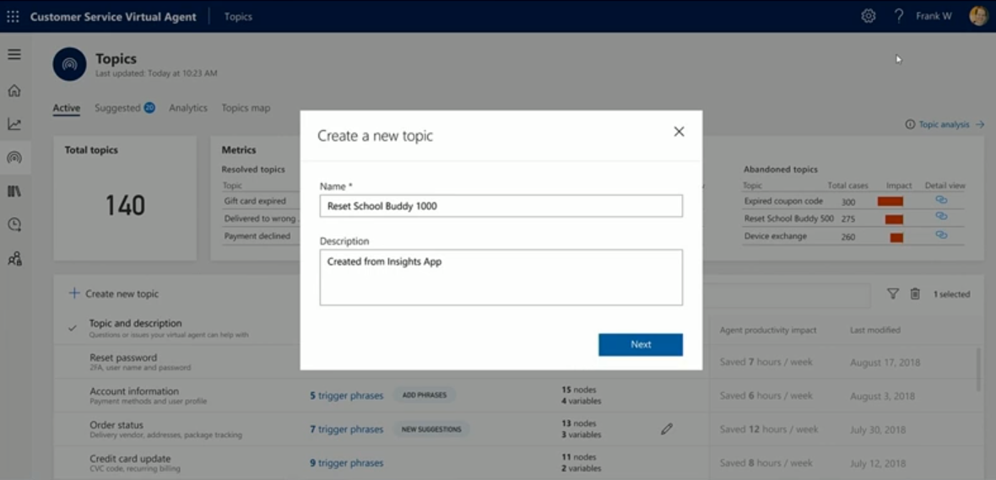
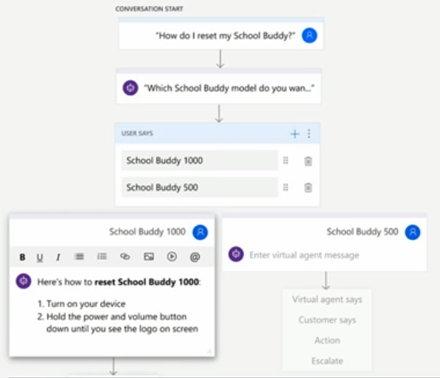
Customer Service Virtual Agent
BRK2398

Slide 19



Omni-channel Engagement Hub
BRK2152
Channels/Touch Points
Live Engagement Modes
Agent Assist - Bot
CRM
Customer Insights
Social Media Monitoring
Order Management
Web
Mobile
Video
Chat
Technicians
Offer Management
Consumer Loans
Credit Check
Agent
Bots
Social
Co-browse
Secure Docs
Eligibility
Premiums
Resources
…
Secure Messaging
2-way Text
Store
Phone / Chat
Supervisor
Preserve Context
Journey Mapping
Channel Escalation
Unified Customer View Across LoB

Slide 20
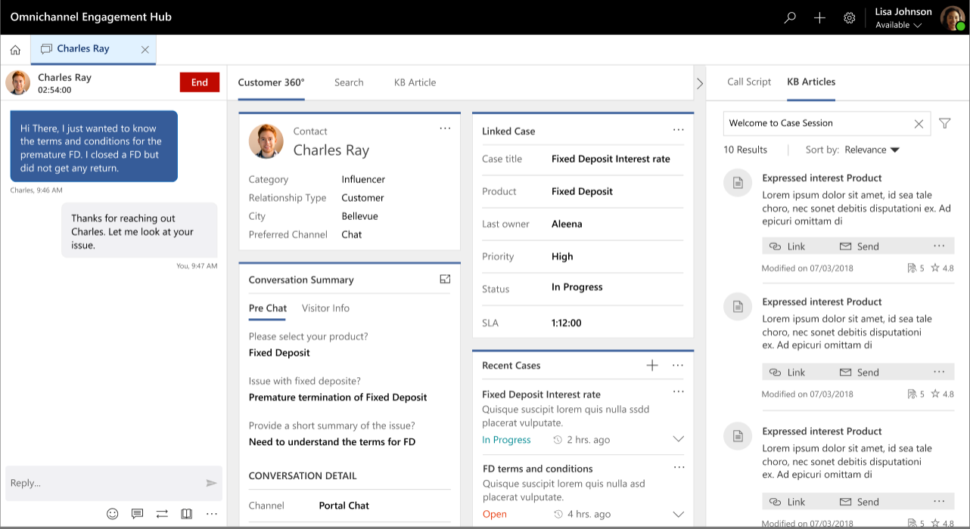
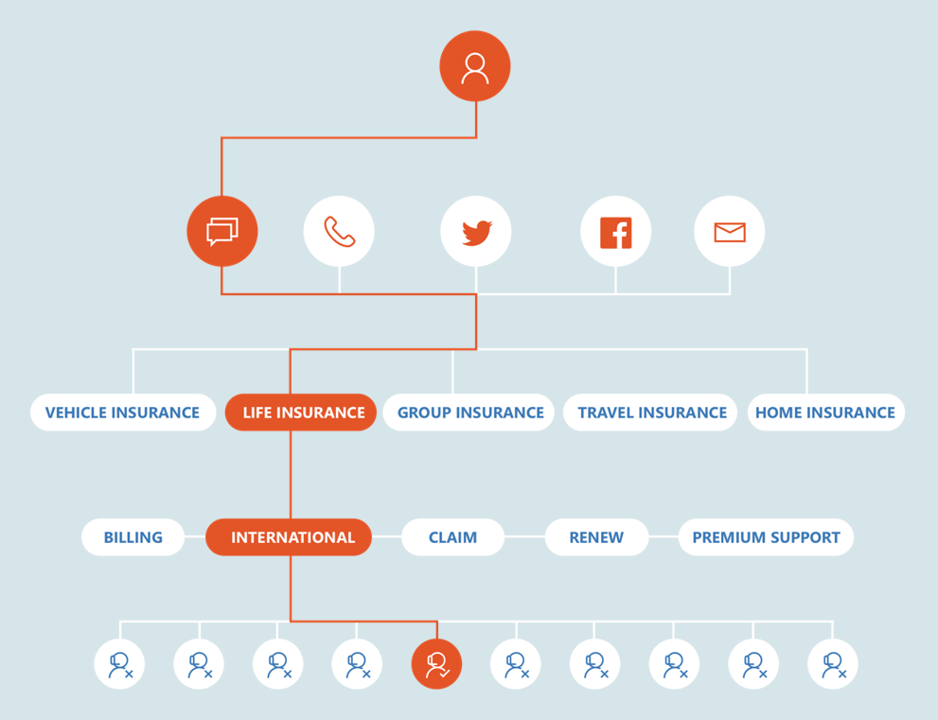
Omni-channel Engagement Hub
BRK2152
DEC 2018 - PREVIEW
Channels
Live Chat Channel
Enable Live chat support channel (D365 portal & Custom Websites)
SMS Channel
Enable SMS support channel (inbound & outbound messaging)
Channel Integration Framework (Phone)
Partners can embed cloud telephony UI and enable data exchange
Enable Customer to Bring their Bots
Integration with Microsoft bot framework for deflection & escalation scenarios
Engagement
Agent & Supervisor Experiences
Simple, easy to learn, unified experience; manage agent workforce; real-time monitoring
Unified Routing & Work Distribution
Configurable, Automated, Intelligent routing of work items from different channels
Insights
Intelligent Insights
Suggested Articles, Related Items, KPIs

Slide 21
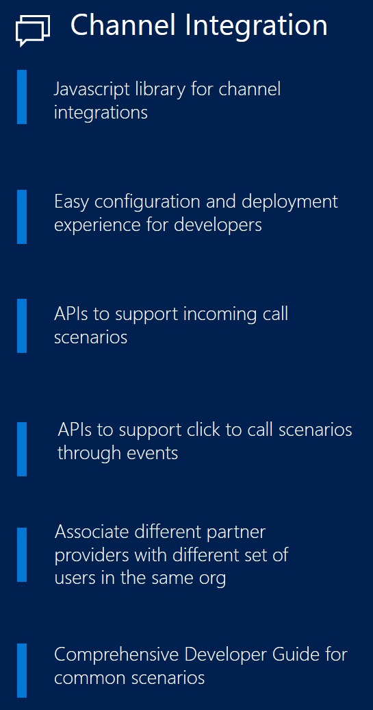
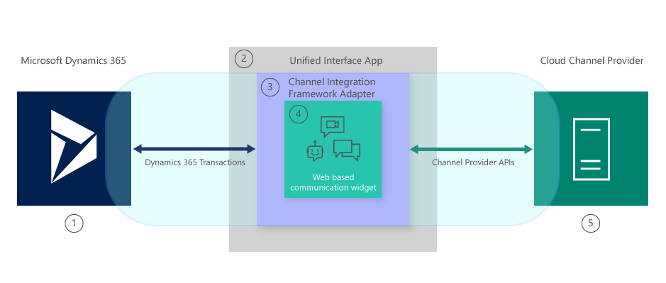
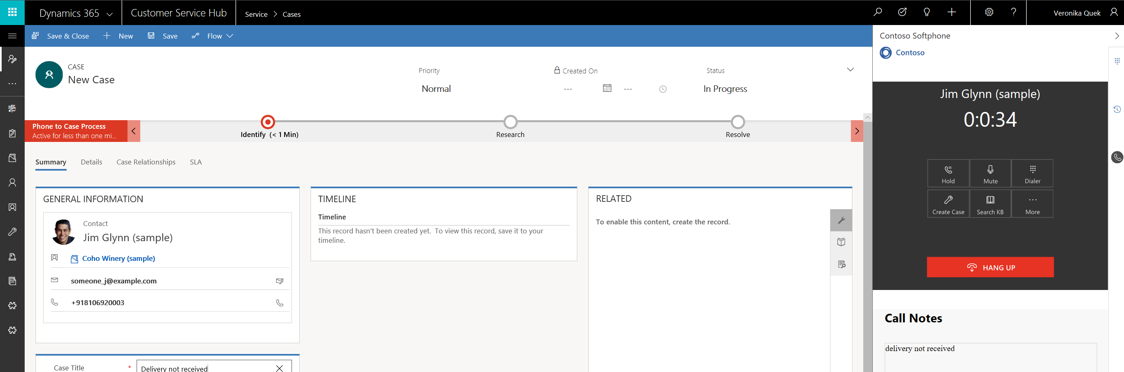
Channel Integration Framework
Public preview

Slide 22
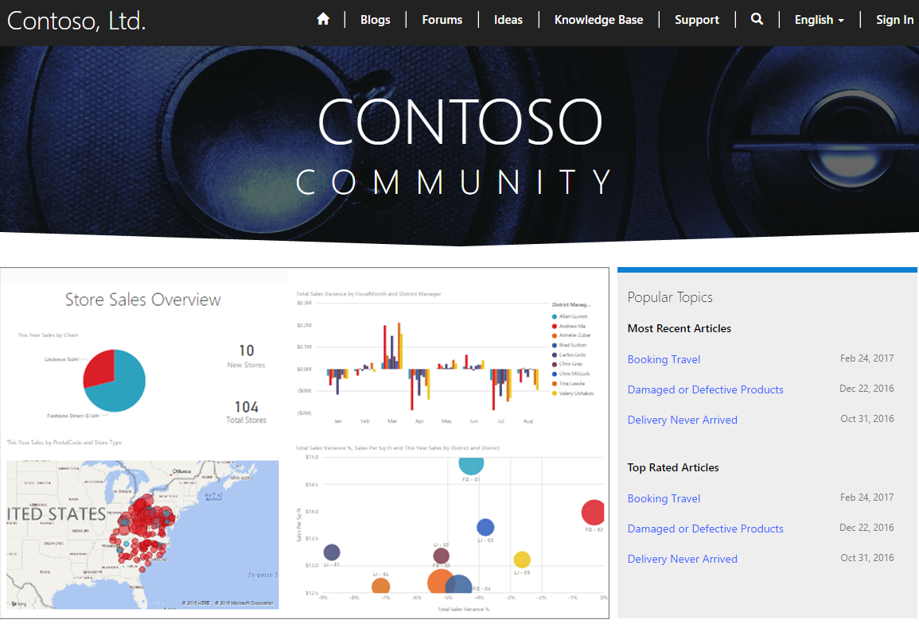
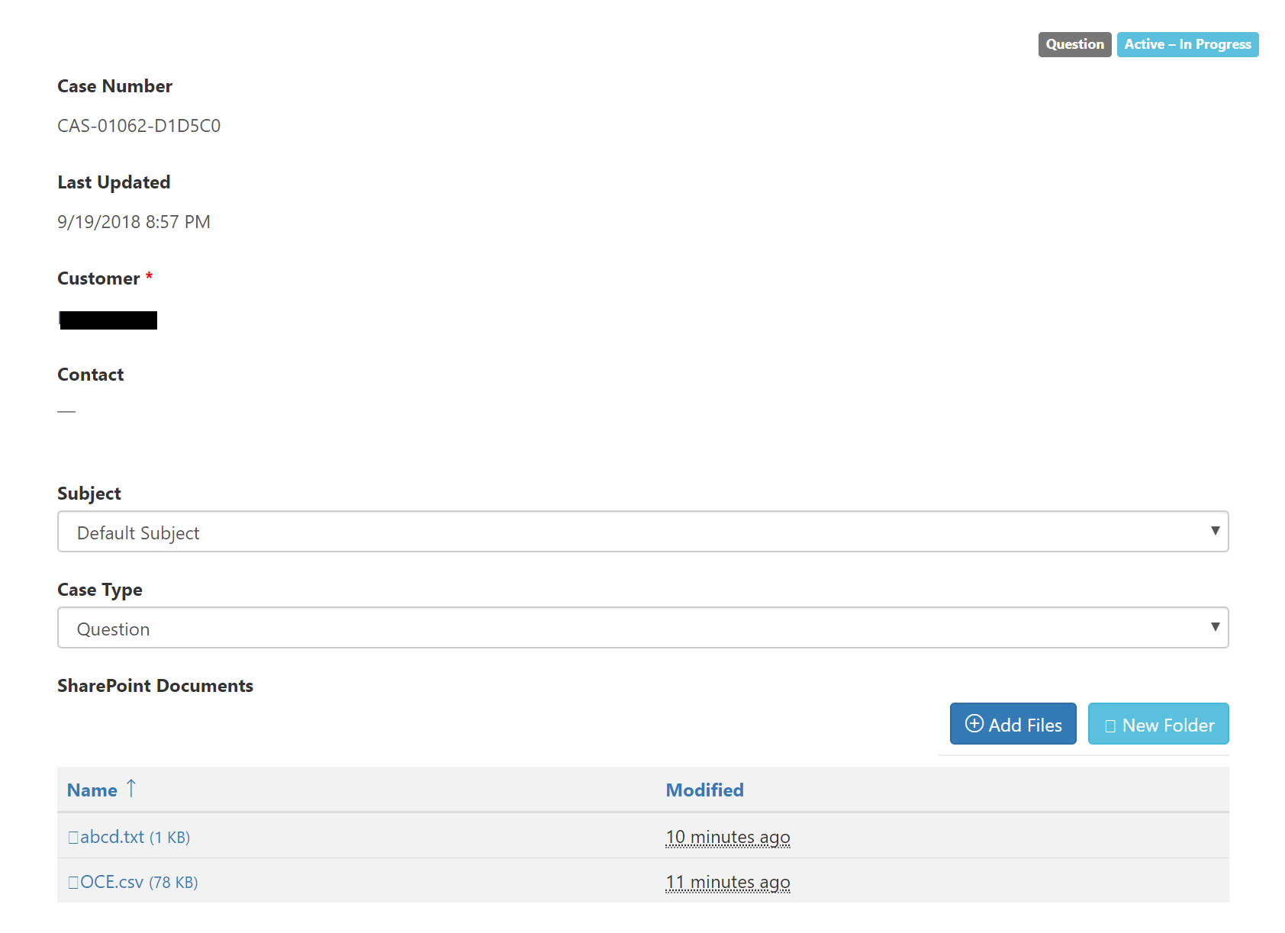
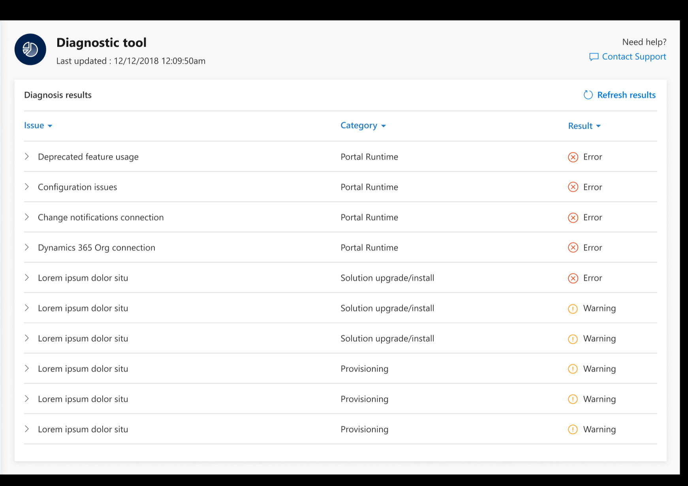
Portals
BRK2151

Slide 23
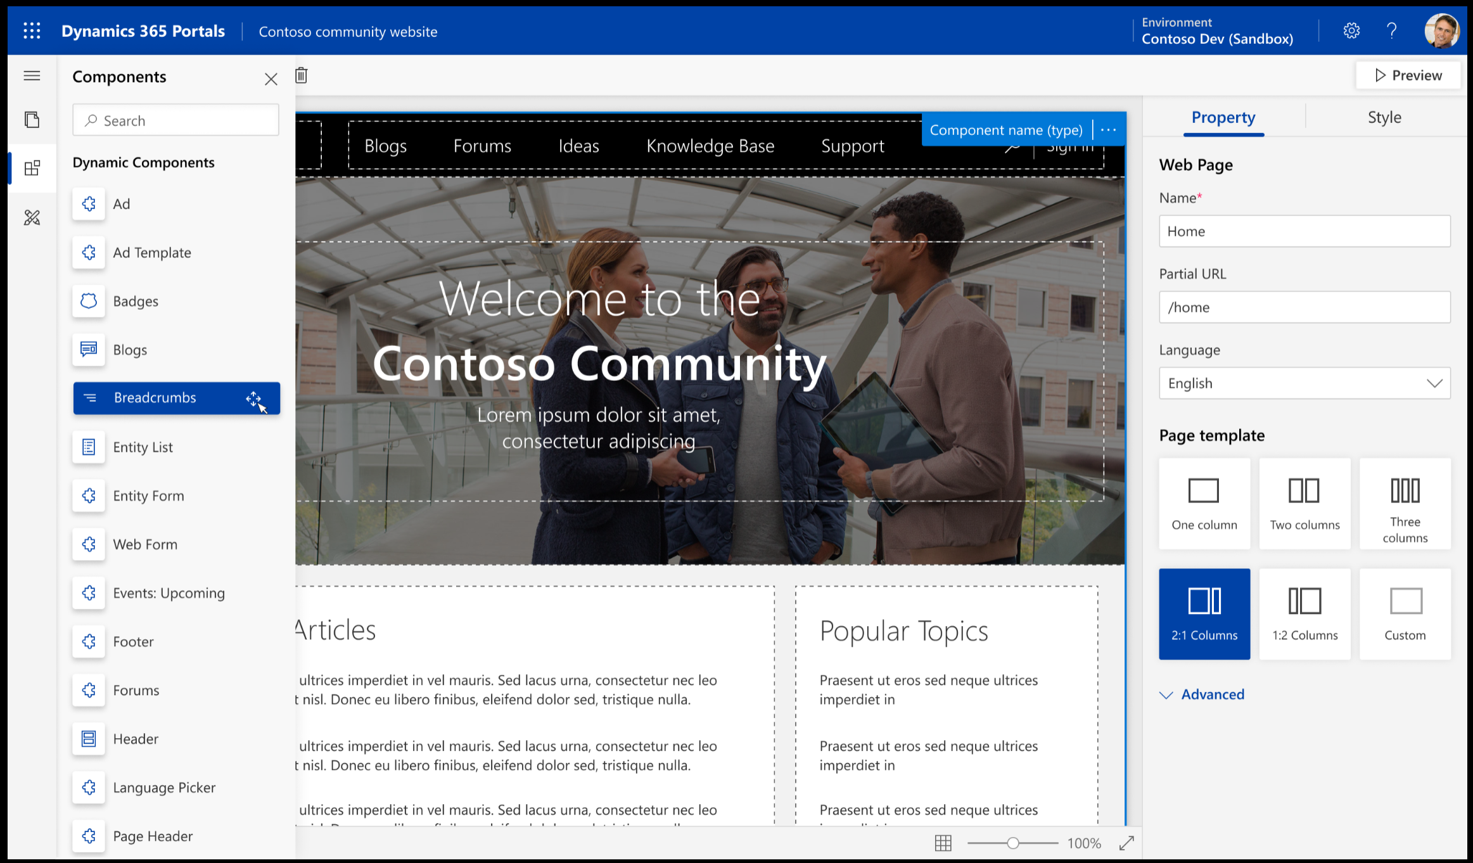

Slide 24
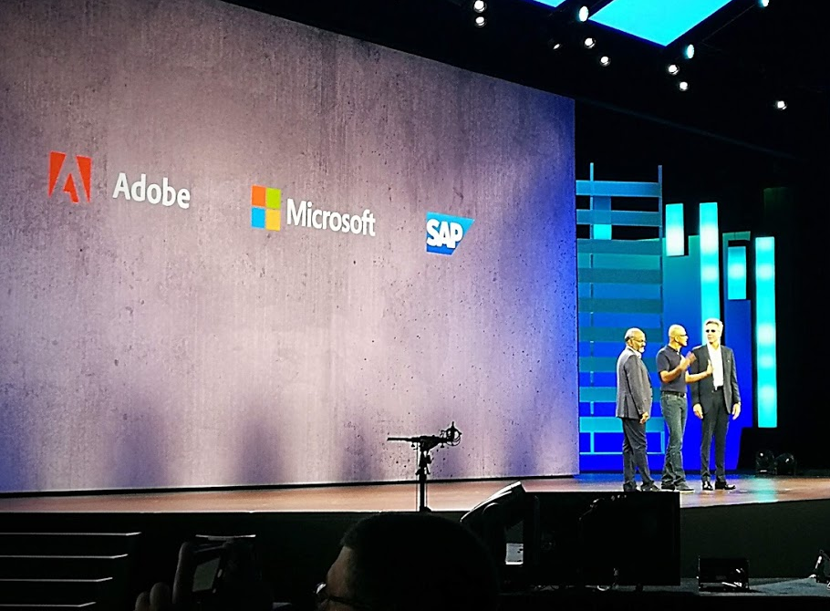
Open Data Initiative
Press release
Unlock and harmonize siloed data to create new value
Bi-directionally move transactional, operational, customer or IoT data to and from the common data lake based on their preference or needs
Create data-powered digital feedback loops for greater business impact, while also helping to enable their security and privacy compliance initiatives
Build and adopt intelligent applications that natively understand data, relationships and metadata spanning multiple services from Adobe, SAP, Microsoft and their partners

Slide 25
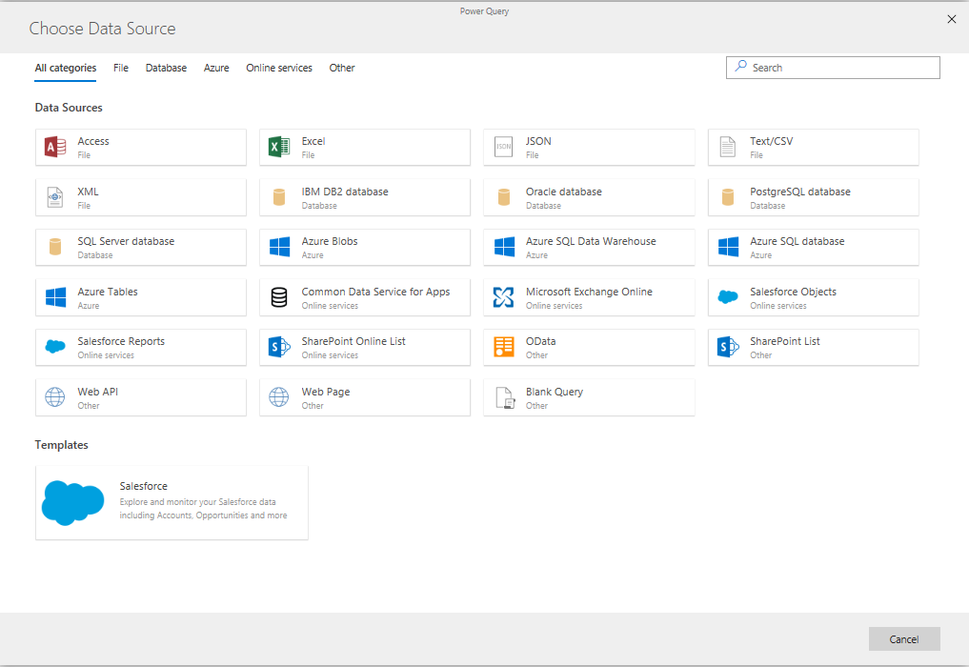
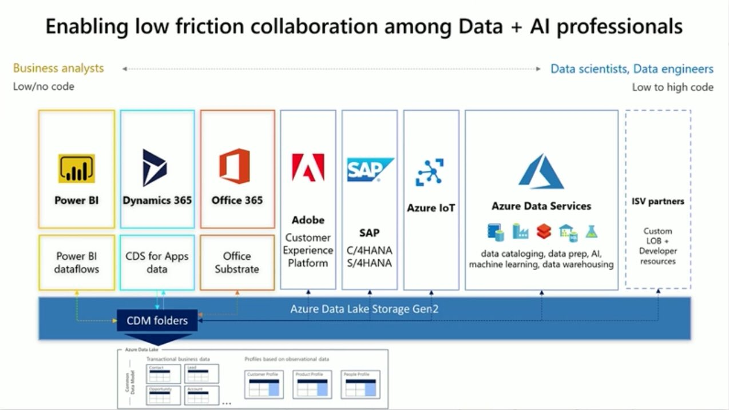
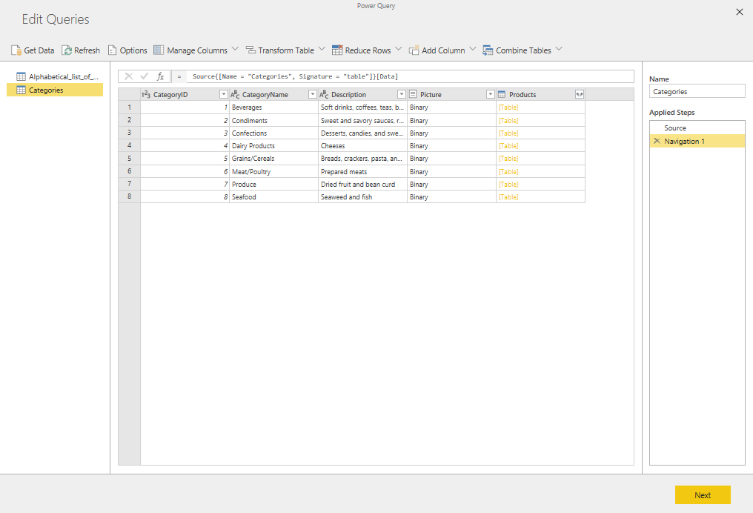
Common Data Model (CDM)
BRK2052
https://aka.ms/cdmposter

Slide 26
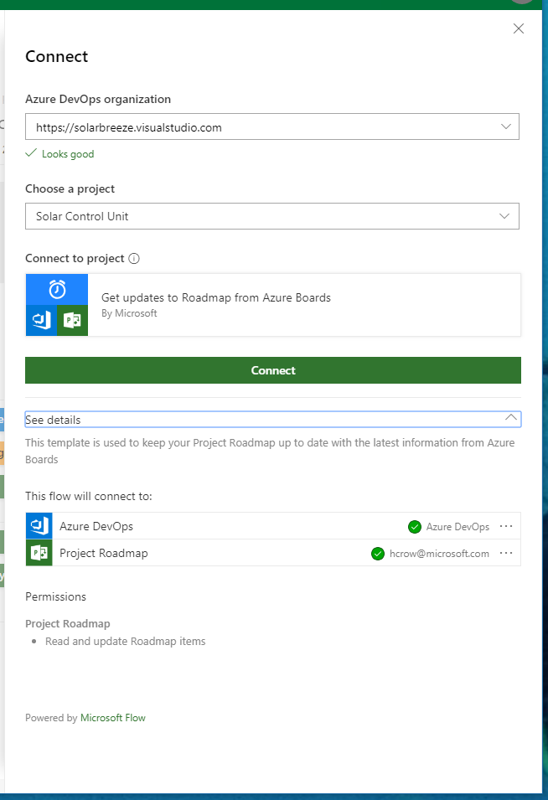
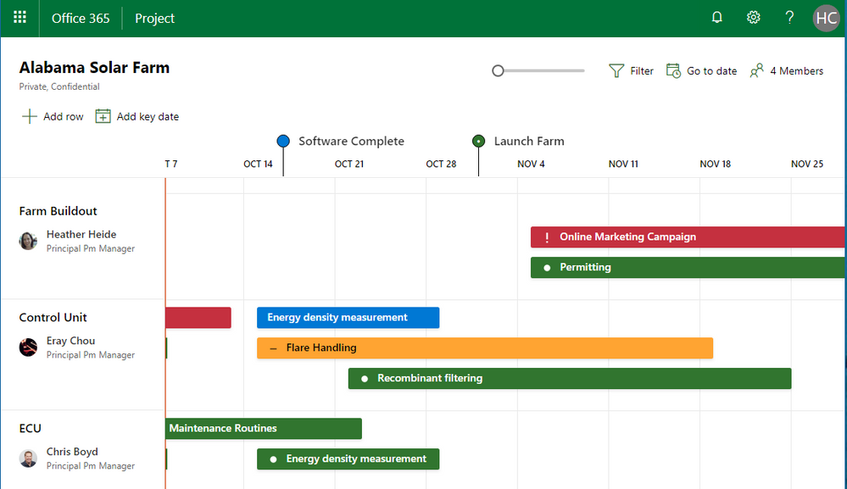
”New Microsoft Project”
Tech Community

Slide 27
”New Microsoft Project”
Azure DevOps
Project
Power Platform
Azure
Boards
Roadmap
Home
Project
Management
Project
Client
Project
Web App
PowerBI
PowerApps
Flow
MRU & Roaming
Azure
PCS
Azure
Common Data Service for Apps
Roadmap
Sales
Project Management
Field Service
Customer Service
Time &
Expense
Resource
Management

Slide 28



Slide 29





Elisa @ Ignite 2018
THR2224

Slide 30

EXPO: BUSINESS APPLCIATIONS

Slide 31
That’s all!

Slide 32
https://www.dynamics365.fi/
Notes:
Kenelle Teams on tuttu?
Onko joku siirtynyt jo Skypestä pois?
-Huomio siitä, että tän kuukauden alusta alle 500hlö organisaatiot ei enää saa Skypeä

